Slide 1
Presentation on “The viability of web-derived polarity lexicons” Presentation by Brendan O’Connor, 3/2/2010 Social Media Analysis course, William Cohen

Slide 2
Background
“The viability of web-derived polarity lexicons” Velikovich, Blair-Goldesohn, Hannan, McDonald. To appear, NAACL-2010
NY/Google sentiment group; Natalie Glance’s presentation touched on this particular work
(Some) authors’ previous work: “Structured models for fine-to-coarse sentiment analysis”, McDonald et al 2007
This presentation is based on a DRAFT VERSION
Outline
Lexicon expansion approach
Contextual similarity
Graph propagation algorithm
Evaluations
Direct
Task

Slide 3
Polarity Lexicons
Word lists with polarity
excel => POSITIVE
woeful => NEGATIVE
Hand-constructed: General Inquirer, Pitt (Wilson et al), or ad-hoc (e.g. Das and Chen)
Lexicon extension
Find more examples via contextual similarity to initial seeds
Similar recent (non-sentiment) work: expansion of sets (Wang 2009, thesis), WordNet (Snow 2009, thesis), predicate calculus KB (Carlson 2010, thesis)
Compare: Previous work presented in class
Similar: Turney 2002 (sentiment lexicon extension via web page co-occurrence stats)
Contrast: Pang and Lee 2002, supervised learning from word features
“… the core of many academic and commercial sentiment analysis systems remains the polarity lexicon”

Slide 4
Contextual similarity
You shall know a word by the company it keeps (Firth 1957)
Word radius context window counts
had a great conference call
It was great !
Had a great laugh
Just great it's snowing
Had a nice laugh => hopefully (Had, nice, <>, laugh) is high for both nice and great, but low for bad.
Superficially similar to, but far more sophisticated than, context co-occurrence.

Slide 5
Example (Trivial size: 2M occurrences, Twitter text, >=10 counts)
context "great" "good" "bad"
------- ------- ------ -----
have a <> day ! 0.066 0.011 0.0009
s <> ! 0.042 0.017 0.004
not as <> as it 0.0005 0.002 0.011
sim(great, good) based on context vectors (columns)
This paper does not specify context vector representation (counts? Log-counts?) Above is P( context | word )
Paper uses cosine similarity
“e.g., for sentiment analysis, one would hope that w_ij > w_ik if v_i=good, v_j=great and v_k=bad”
It checks out here!
sim(good, great) = 0.0074
sim(good, bad) = 0.0049
sim(great, bad) = 0.0034

Slide 6
Procedure
Identify ?N words and phrases from 4 billion web pages. Count their size-6 contexts
Construct term similarity graph: cosine similarity of context vectors (probabilities??)
Graph propagation from seeds => computed edge weights tell you new polar words
Seed: a few hundred pos/neg words “from a set of five humans”

Slide 7
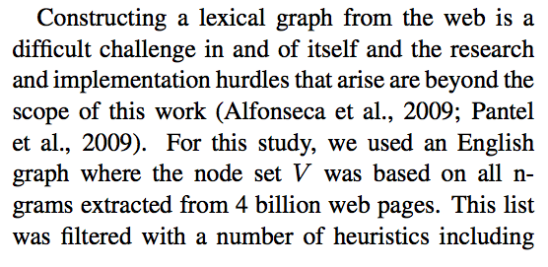
Term finding (Replicability?)
Sounds like they already had a phrase finder
Speculation: if you simply take all unfilitered n-grams, the whole thing doesn’t work.

Slide 8
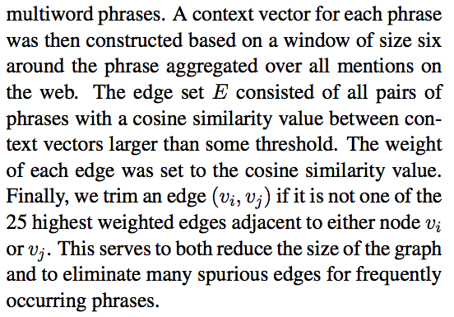
Thresholding (Replicability!)

Slide 9
Graph Propagation Algorithm
[I’m a little confused, this may not be perfect…]
Pre-computed cosine similarity weights
For each pos/neg seed, find the best (multiplicative) path score to every term in the graph.
Iterative max-multiplicative propagation creates two new bipartite graphs
Pass #1: positive polarity graph (weighted seed-term edges)
Pass #2: negative polarity graph (weighted seed-term edges)
For a single word, look at computed edge weights to positive vs. negative seeds. Basically sum them to assign final word polarities.

Slide 10
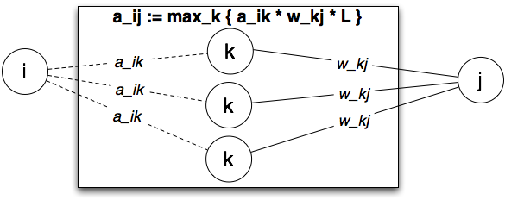
Graph Propagation Algorithm
w_ij graph: cosine similarity (empirical from data; fixed).
a_ij graph: computed polarity EDGES (*not* per-node weights)
The innermost loop:
Want new a_ij. Look over neighbors k already having an a_ik

Slide 11
Technical Details
Final polarities. A term has
Pos score: Sum \alpha weights from pos seeds
Neg score: Sum \alpha weights from neg seeds
Sum and play with ratios => final polarity score
Parameters
Max T iterations – is OK since fast drop-off anyways
Extra \lambda dropoff per hop
Assign polarity zero unless pos/neg score beyond \gamma

Slide 12
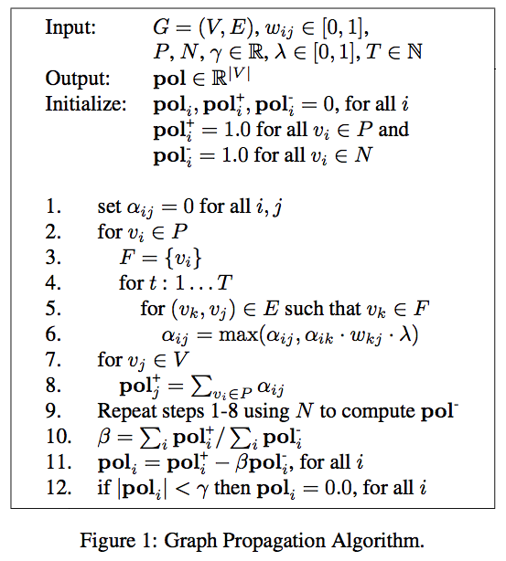

Slide 13
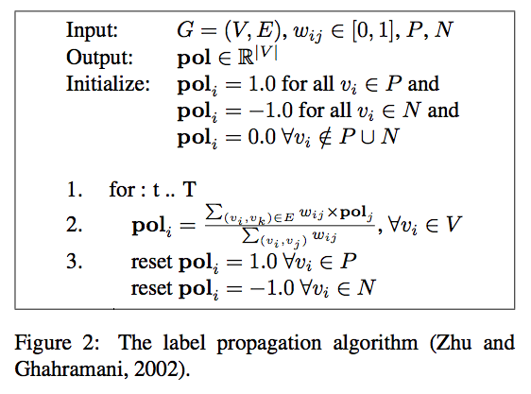
Bad: Label Propagation Algorithm
Sum of all path weights between nodes
Matrix mult, PageRank, random walks
Previous work on WordNet (Blair-Goldensohn et al 2008)
Fails since many entity-class-specific dense subgraphs
Overamplified
Convergence issues
Fails since noisy graphs
They find their max rule – only 1 path is used, not all – is better behaved

Slide 14
Results

Slide 15
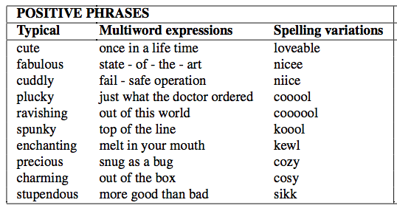
Words!

Slide 16
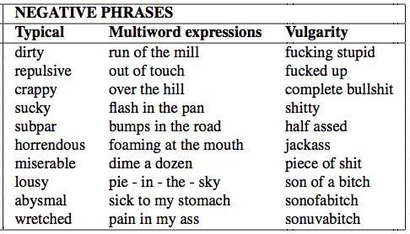
Words!

Slide 17
They note
In positives but not negatives:
Spelling variations
In negatives but not positives:
Insults, outbursts
Derogatory terms, racial slurs
(they’re hinting at, more exclamatives, interjections, and emotive communication in general?)
In all cases
Multiwords and lexical creativity!
Compare: manual lexicon efforts
Weakness: NO PRECISION EVALUATION!

Slide 18
Term lengths
Modal length 2
odd: should be sparser
Adverb/adjective phrase: “more brittle” “less brittle”.
Polarity scores violate ideal ordering: “brittle” is stronger. Future work, compositional semantics?
?? Why no numbers? Manual evaluation won’t hurt you!

Slide 19
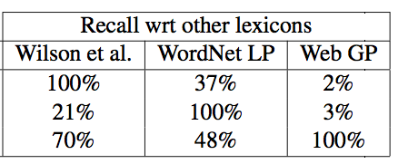
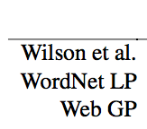
Comparison to previous work
Lexicon sizes. They don’t look at lexicon precision/quality.
I think this is

Slide 20
Sentence Classification
3916 annotated sentences from product reviews (McDonald et al 2007)
Classify pos vs neg vs neutral
Two systems
Lexical matching
Vote-flip algorithm (Choi and Cardie 2009)
Ranking: Purity score
Normalized sum of sentiment phrase scores
Contextual classifier: classify prev/next sentences

Slide 21
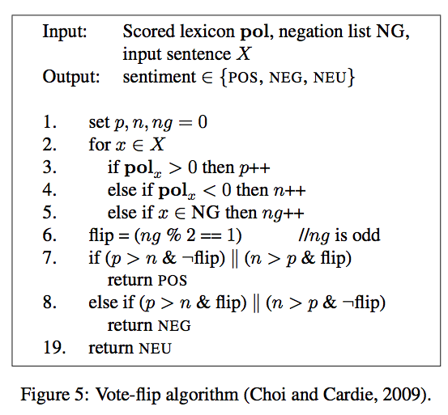

Slide 22
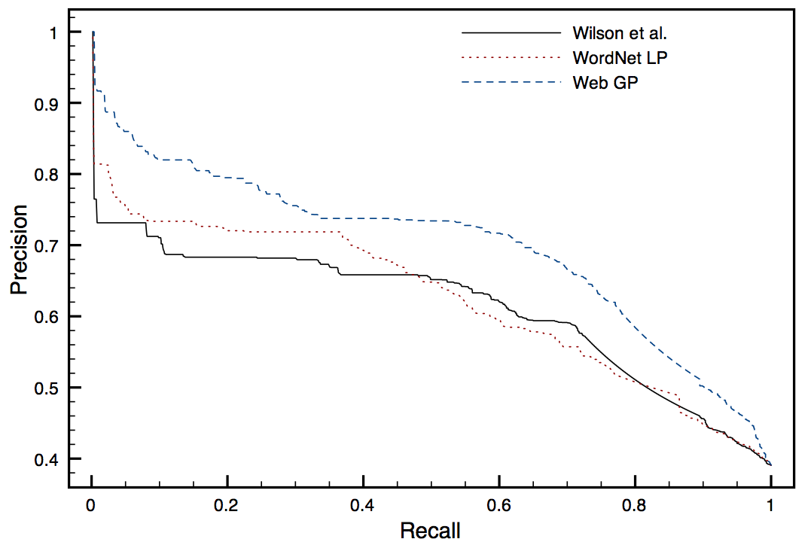
Positive sentence detection

Slide 23
Their lexicon is better
Bigger lexicons are better
Contextual classifier beats single-sentence lexical matching
Lexicon gains are smaller here
Combining all lexicons does best

Slide 24
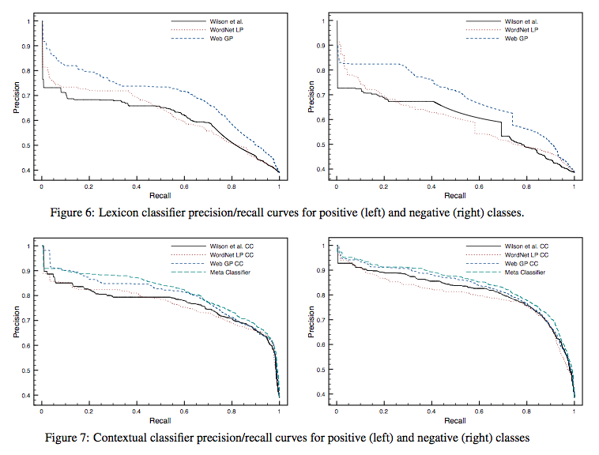

Slide 25
Conclusions
Can build large and rich lexicons from web text
Interesting qualitative phenomena suggest possible future enhancements
New lexicons are useful for sentiment detection
Hopefully this approach works for other languages
Seems likely
Would have been nice to see
Improvements to lexicon vs. sentiment analysis algorithm
Improvements to similarity graph algorithm vs. large data size
What is change to # lexicon hits per sentence? Bin sentences for classifier prec/rec breakdown. Are all gains from 0->1 or 0->2 lexicon hitcount improvements?
Numbers for direct lexicon evaluation: Precision evaluation? Adj/Adv statistics?
Reasonble to seed with all/most of Wilson et al (Pitt lexicon)?

